Slide 1
7Aug17
Final Design
Team #6- Intern’ally Built
Notes:
Zach

Slide 2
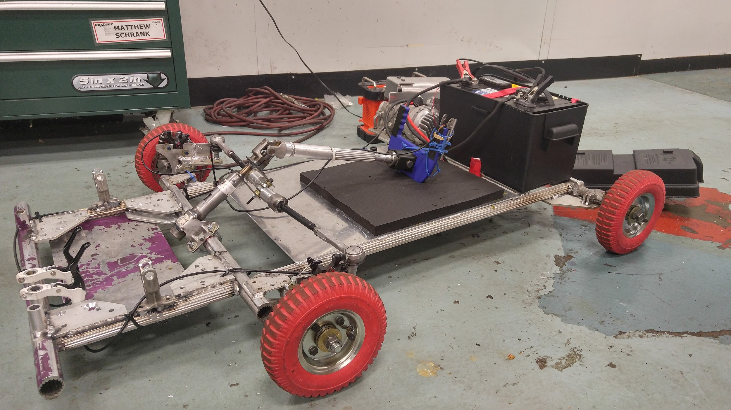
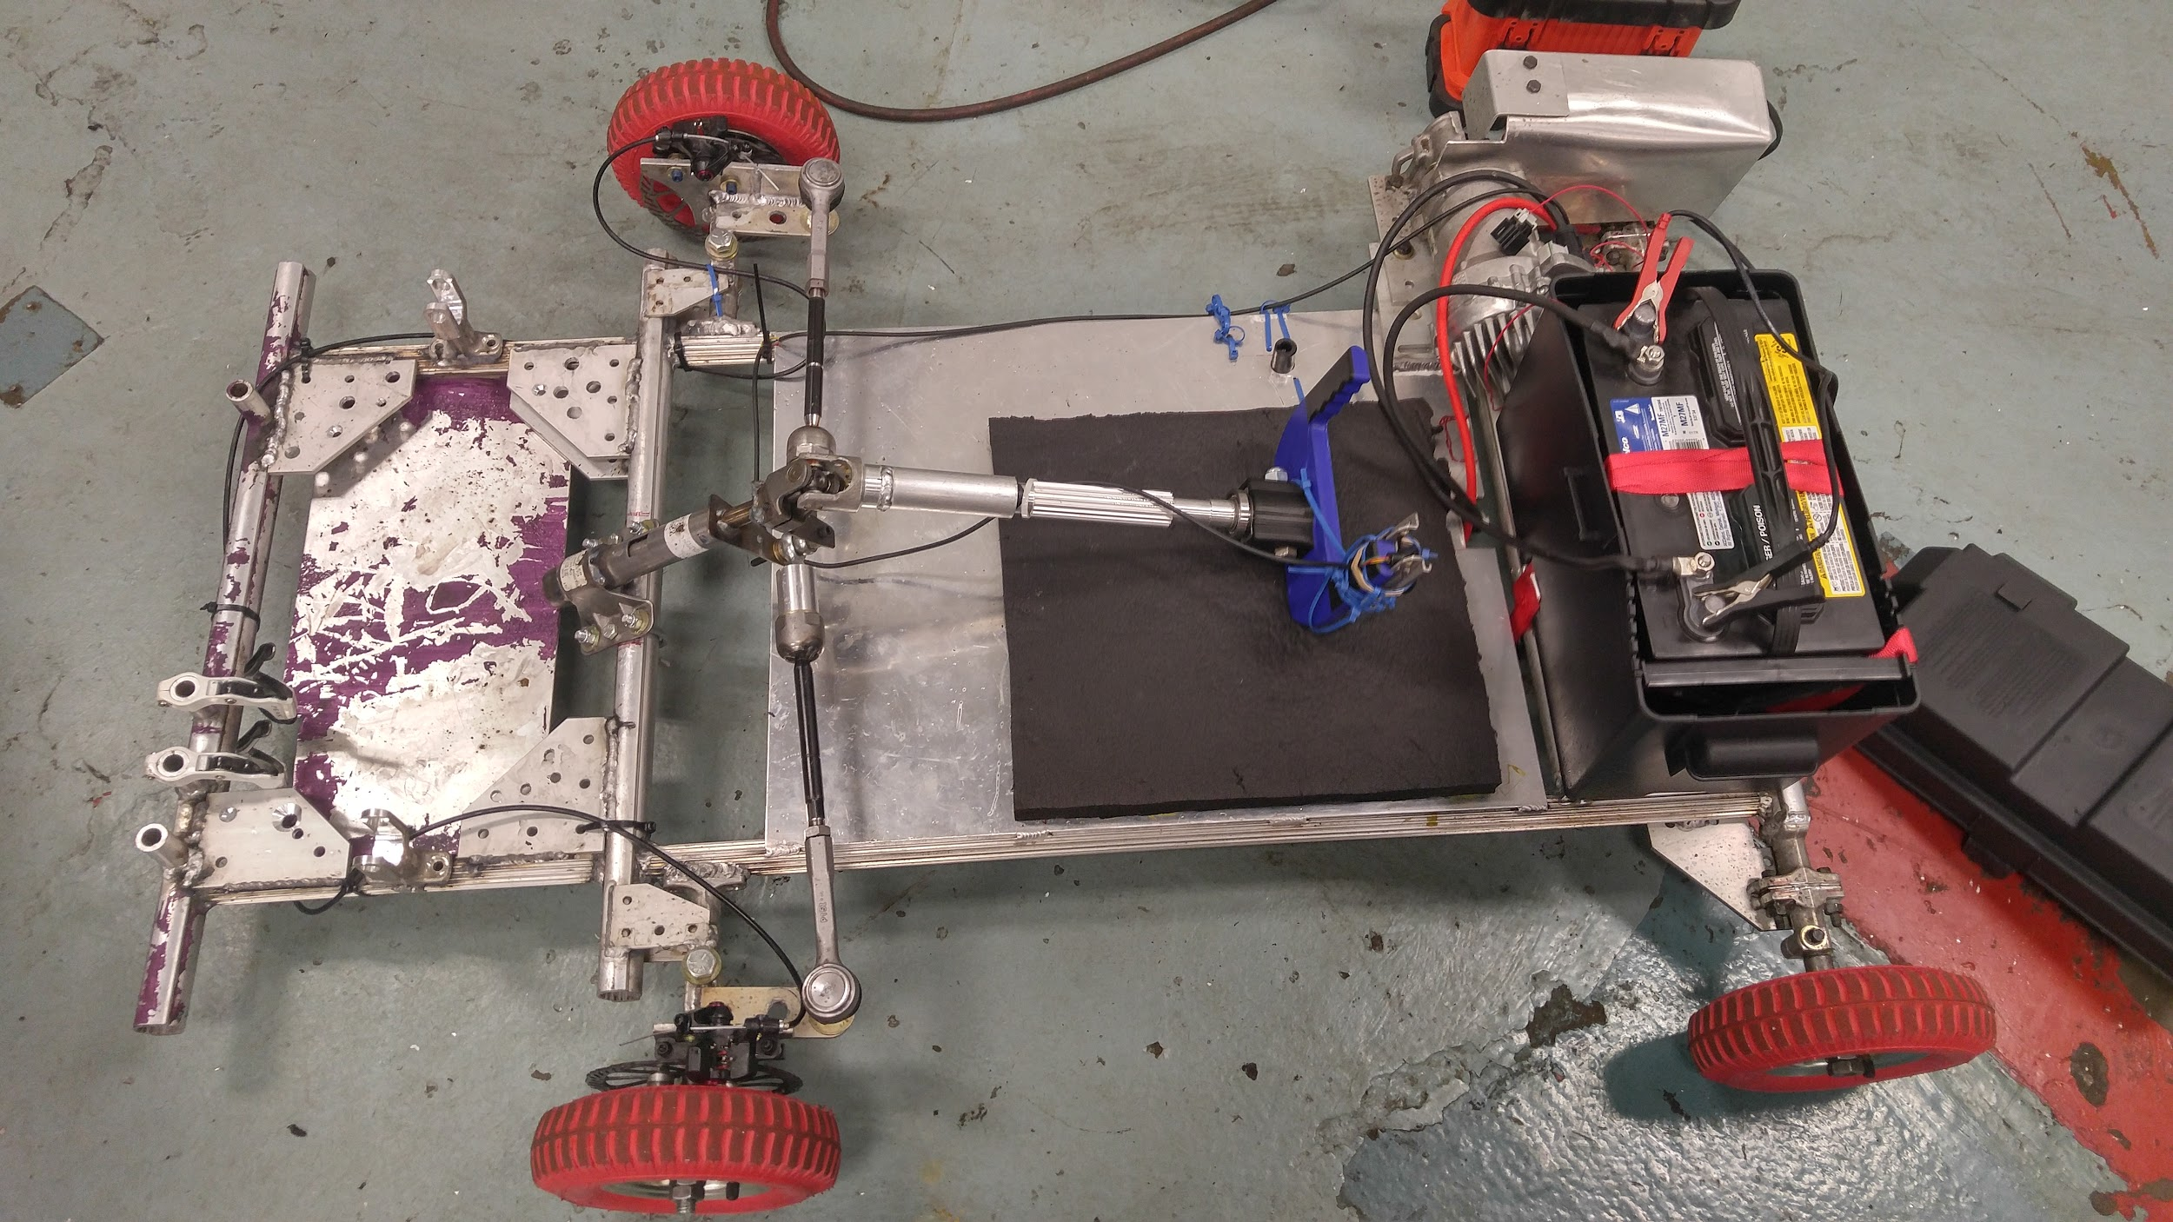
Overall Design
Notes:
Zach

Slide 3
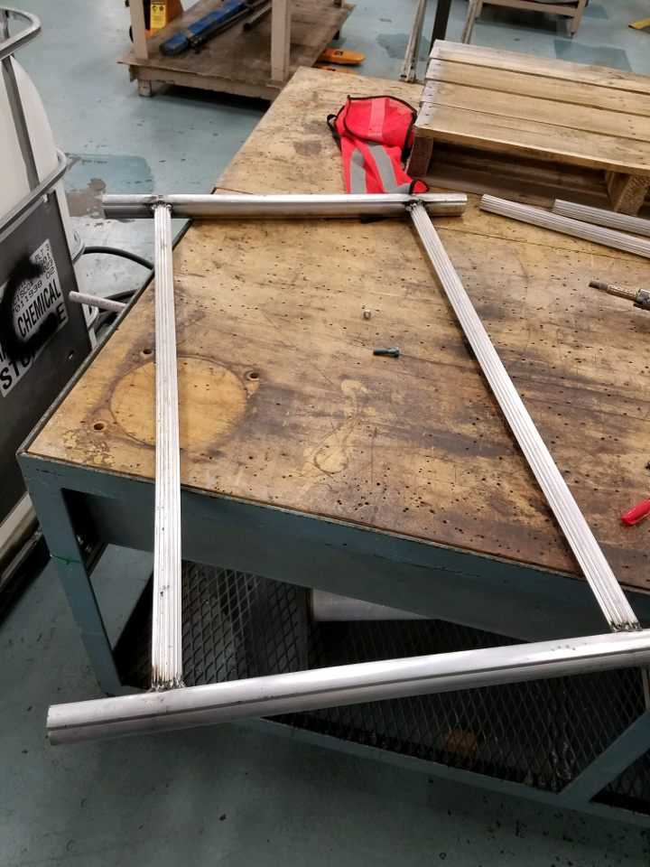
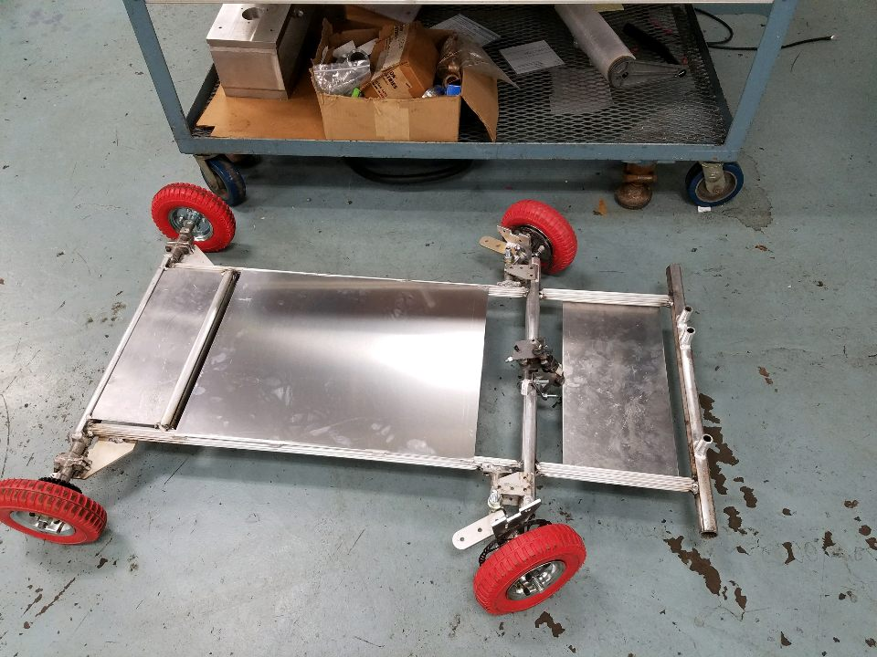
Chassis
The frame itself is made from aluminum I-shaft tubing that are welded together.​
The chassis is made from scraps from Nexteer and is shaped somewhat like a racing go kart chassis.
10 gauge aluminum is used to cover the chassis.
The chassis is reinforced with ¼ inch 80-20 aluminum brackets.
Notes:
Zach

Slide 4
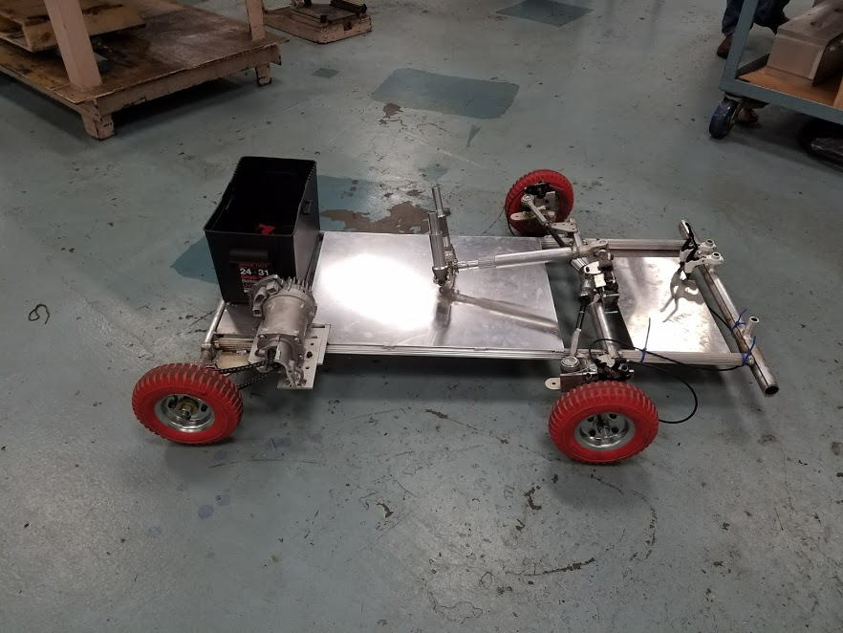
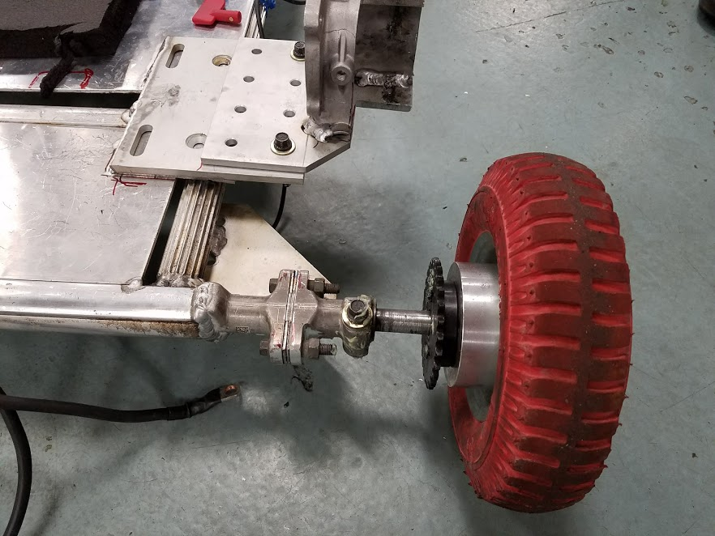
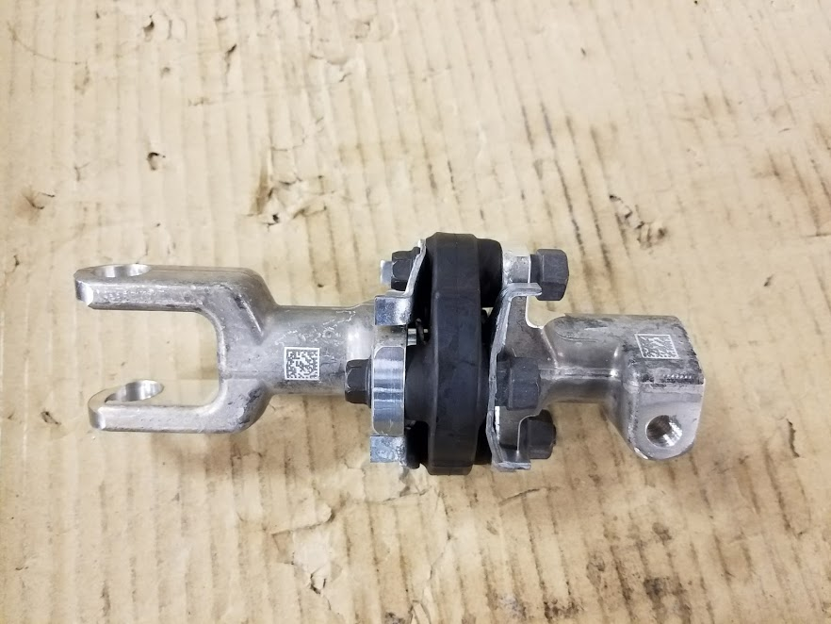
Wheel Layout Design
The wheels are laid out in a rectangle, like a racing go kart, with a front overhang for the drivers feet.
The front wheels are attached to the frame with aluminum U-joints to steer with added bolts, washers and nuts. ​
The rear wheels are attached to the frame using the same U-joints from a columns assembly. A axle is inserted into one end of the for mounting the rear wheels.
Both attachments are reinforced with 80-20 aluminum brackets.
Notes:
Zach

Slide 5
Steering Design: Tie Rods
Tie rods modified with ball joint rod ends on ball joint side.
Bolt spans two steel plates welded to steering column. Bolt goes through ball joint rod ends.
Tie rods connected to U-joint hinges on front wheels via welded plate.
Located above frame behind rear wheels
Driver’s feet go over tie rods
Notes:
Ryan

Slide 6
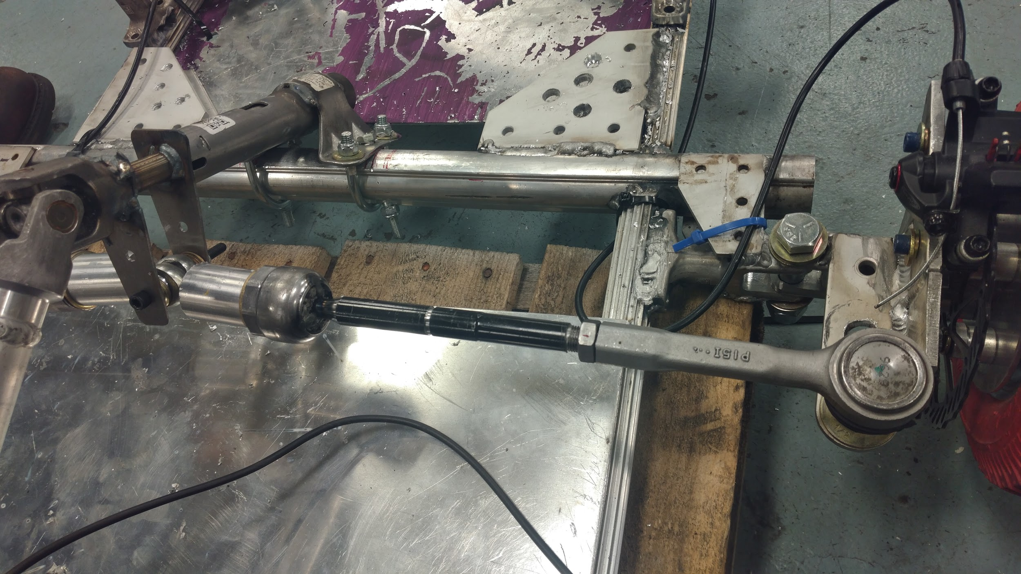
Steering Design: Tie Rods Visuals
Feet go over tie rod to rest here
Ball Joint Rod End to attach to column
Tie rod connects to front corner
Modified Nexteer Tie rod
Machined male to male thread adaptor
Notes:
Ryan

Slide 7
Steering Design: Front Corners
Two U-joint hinges used for revolute joint.
Bolt connects both in line.
1st U-joint hinge welded to frame on flat side.
2nd U-joint hinge has ⅝” bolt through middle, connecting to wheel.
Aluminum plate with holes for tie rod welded to 2nd U-joint hinge.
Notes:
Ryan

Slide 8
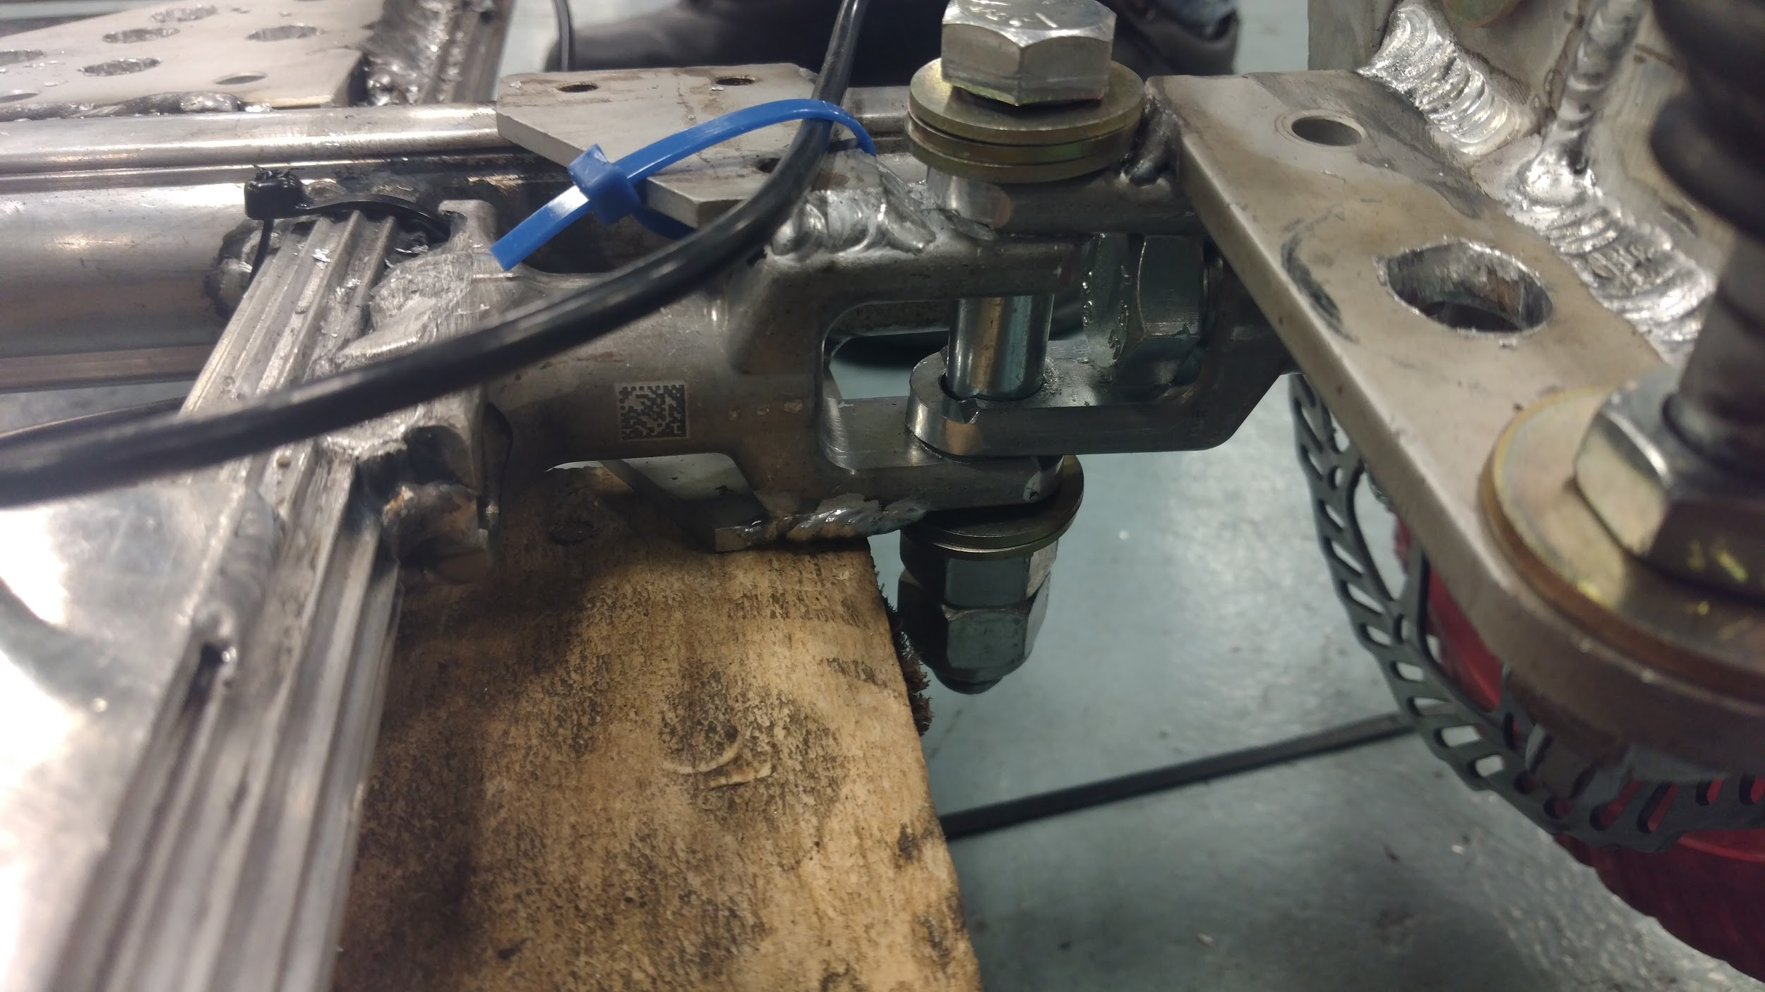
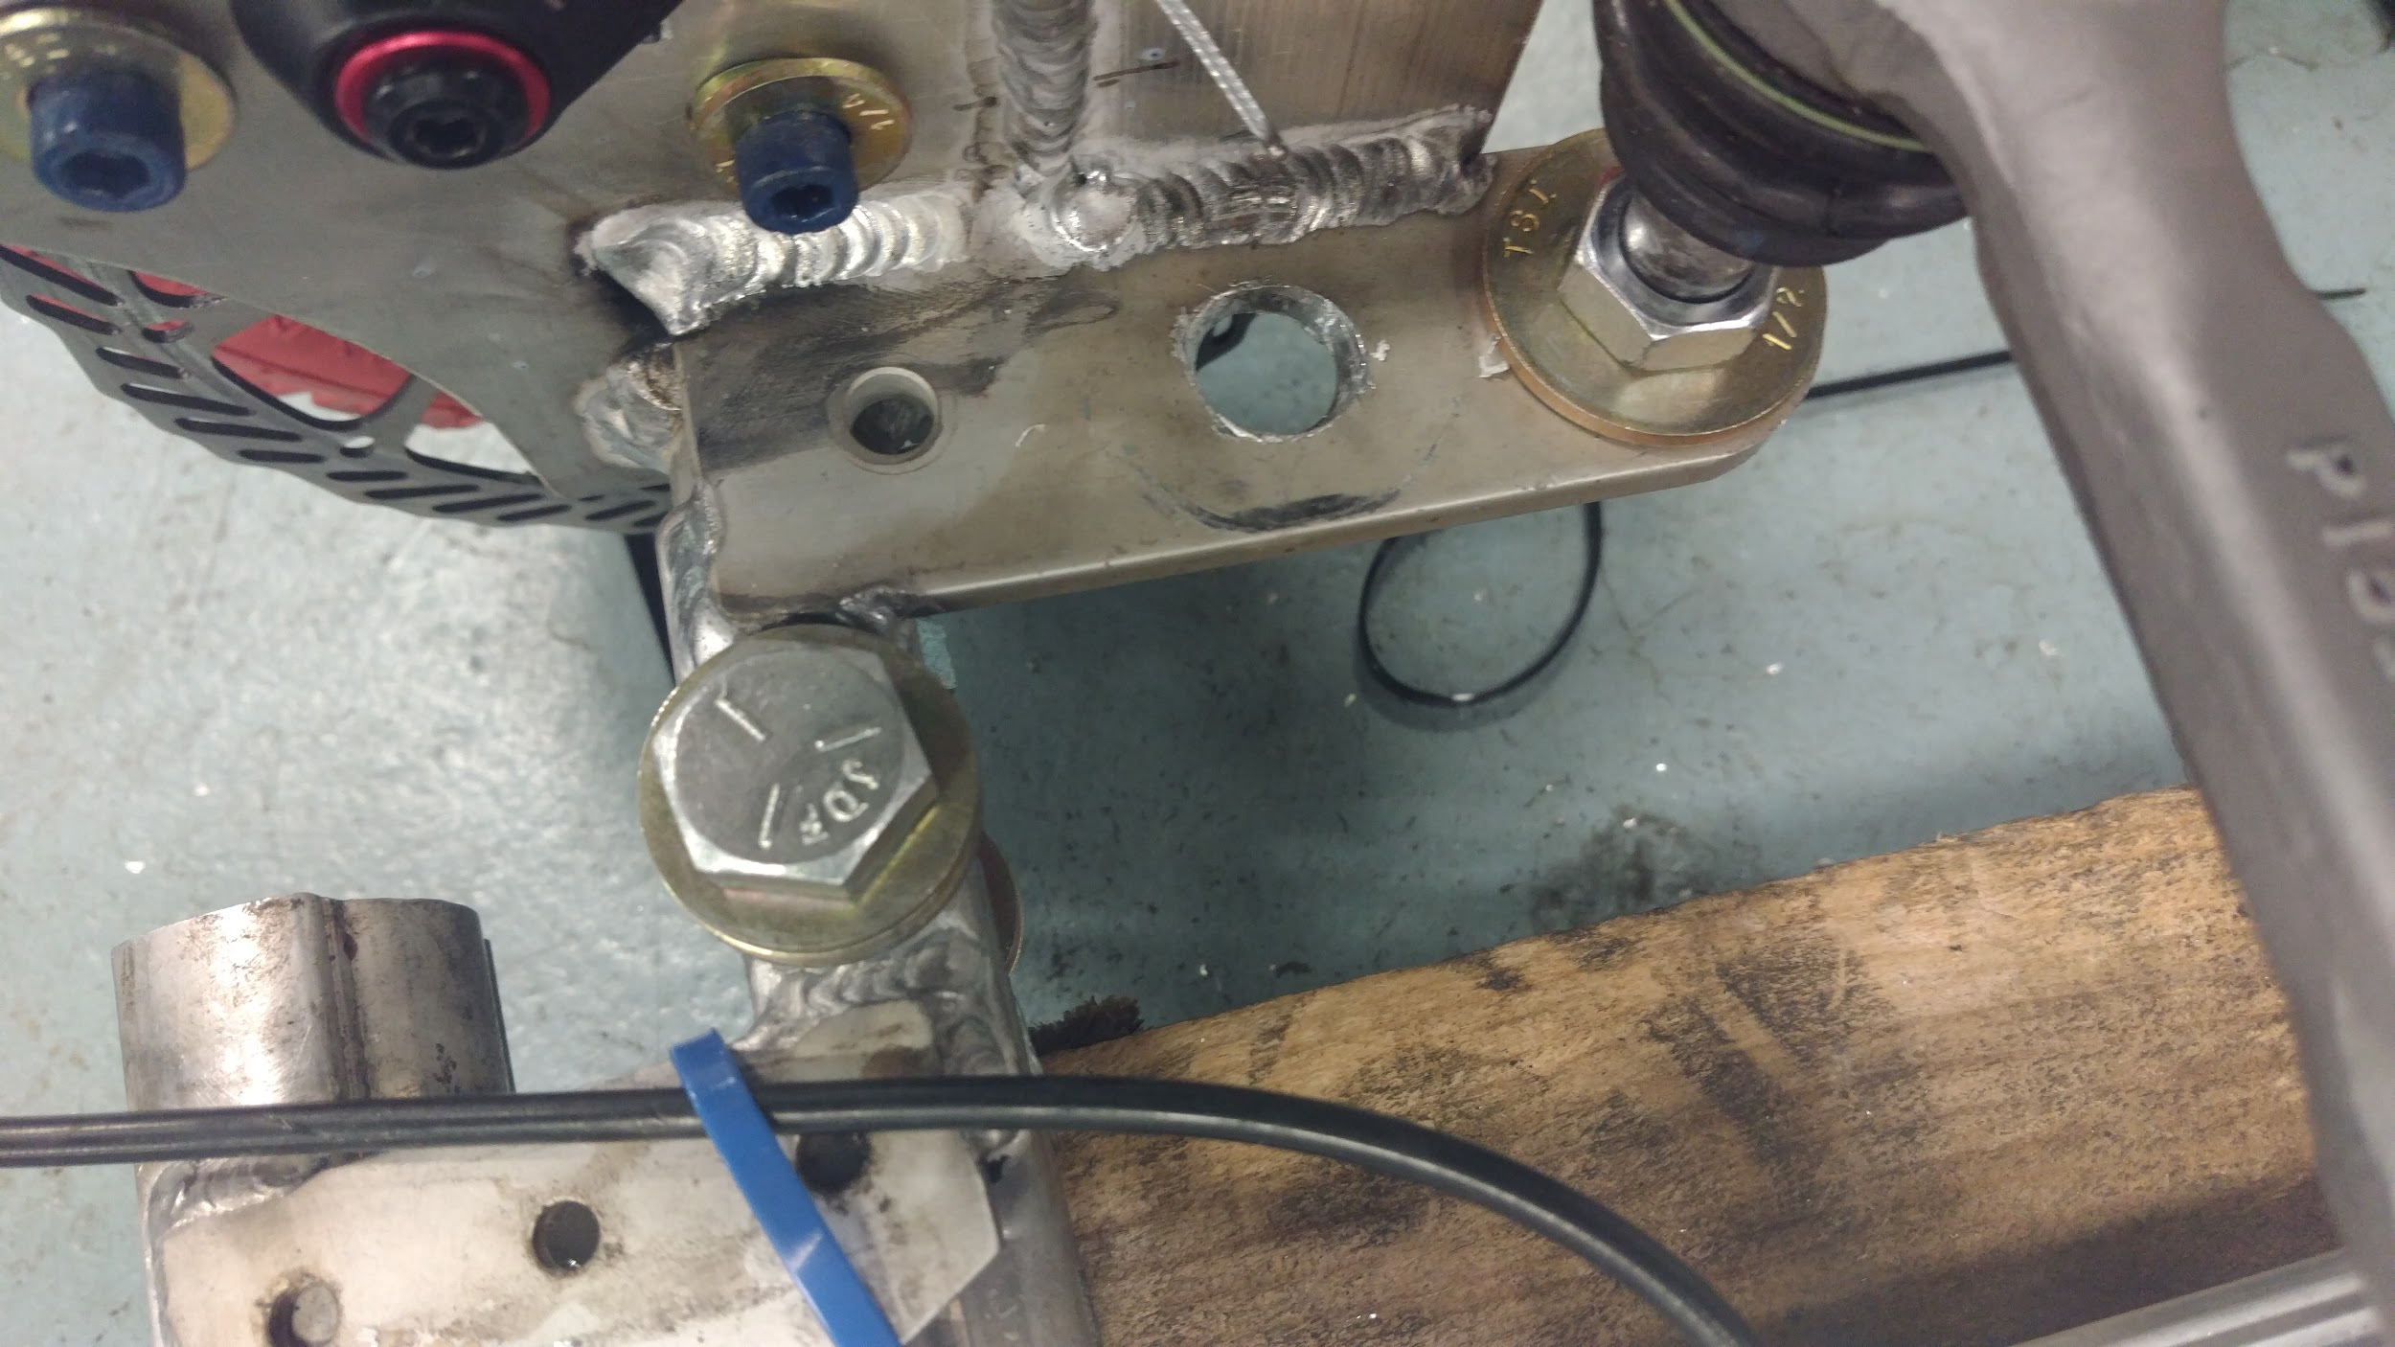
Steering Design: Front Corners Visuals
U-joint hinge welded to frame
Bolt through U-joint hinges forms revolute joint
Multiple holes for adjustability
Bracket welded to U-joint hinge
Tie rod end attaches as pictured
Extra reinforcement
⅝” bolt goes through wheel
Notes:
Ryan

Slide 9
Steering Design – Steering Column
Consists of aluminum steering column piece welded to aluminum and steel U-joint welded to steel steering column piece.
Steering wheel bolts onto top of column.
Steel steering column piece bolts onto frame with U-bolts.
Two bolts go through frame to stop steel steering column piece from rotating
Notes:
Ryan

Slide 10
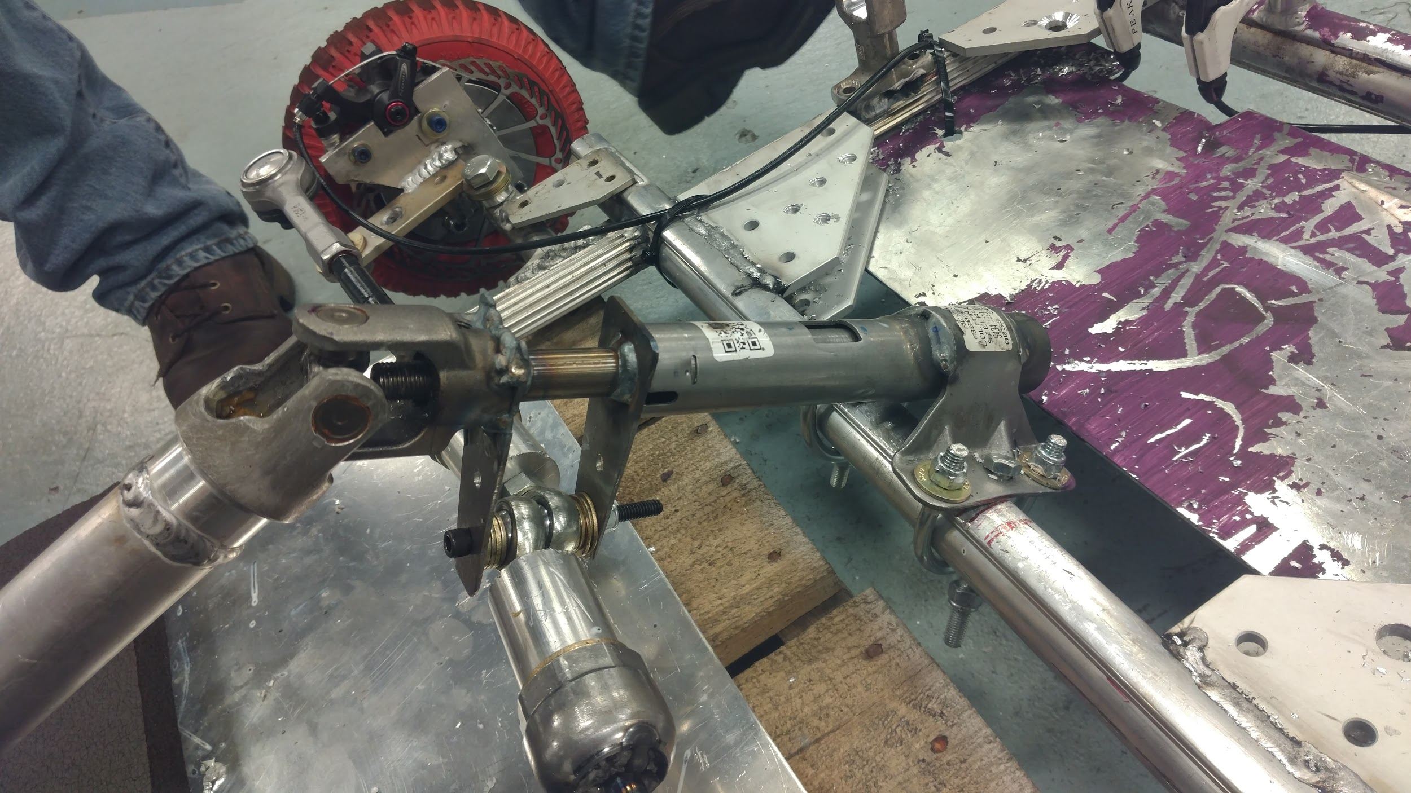
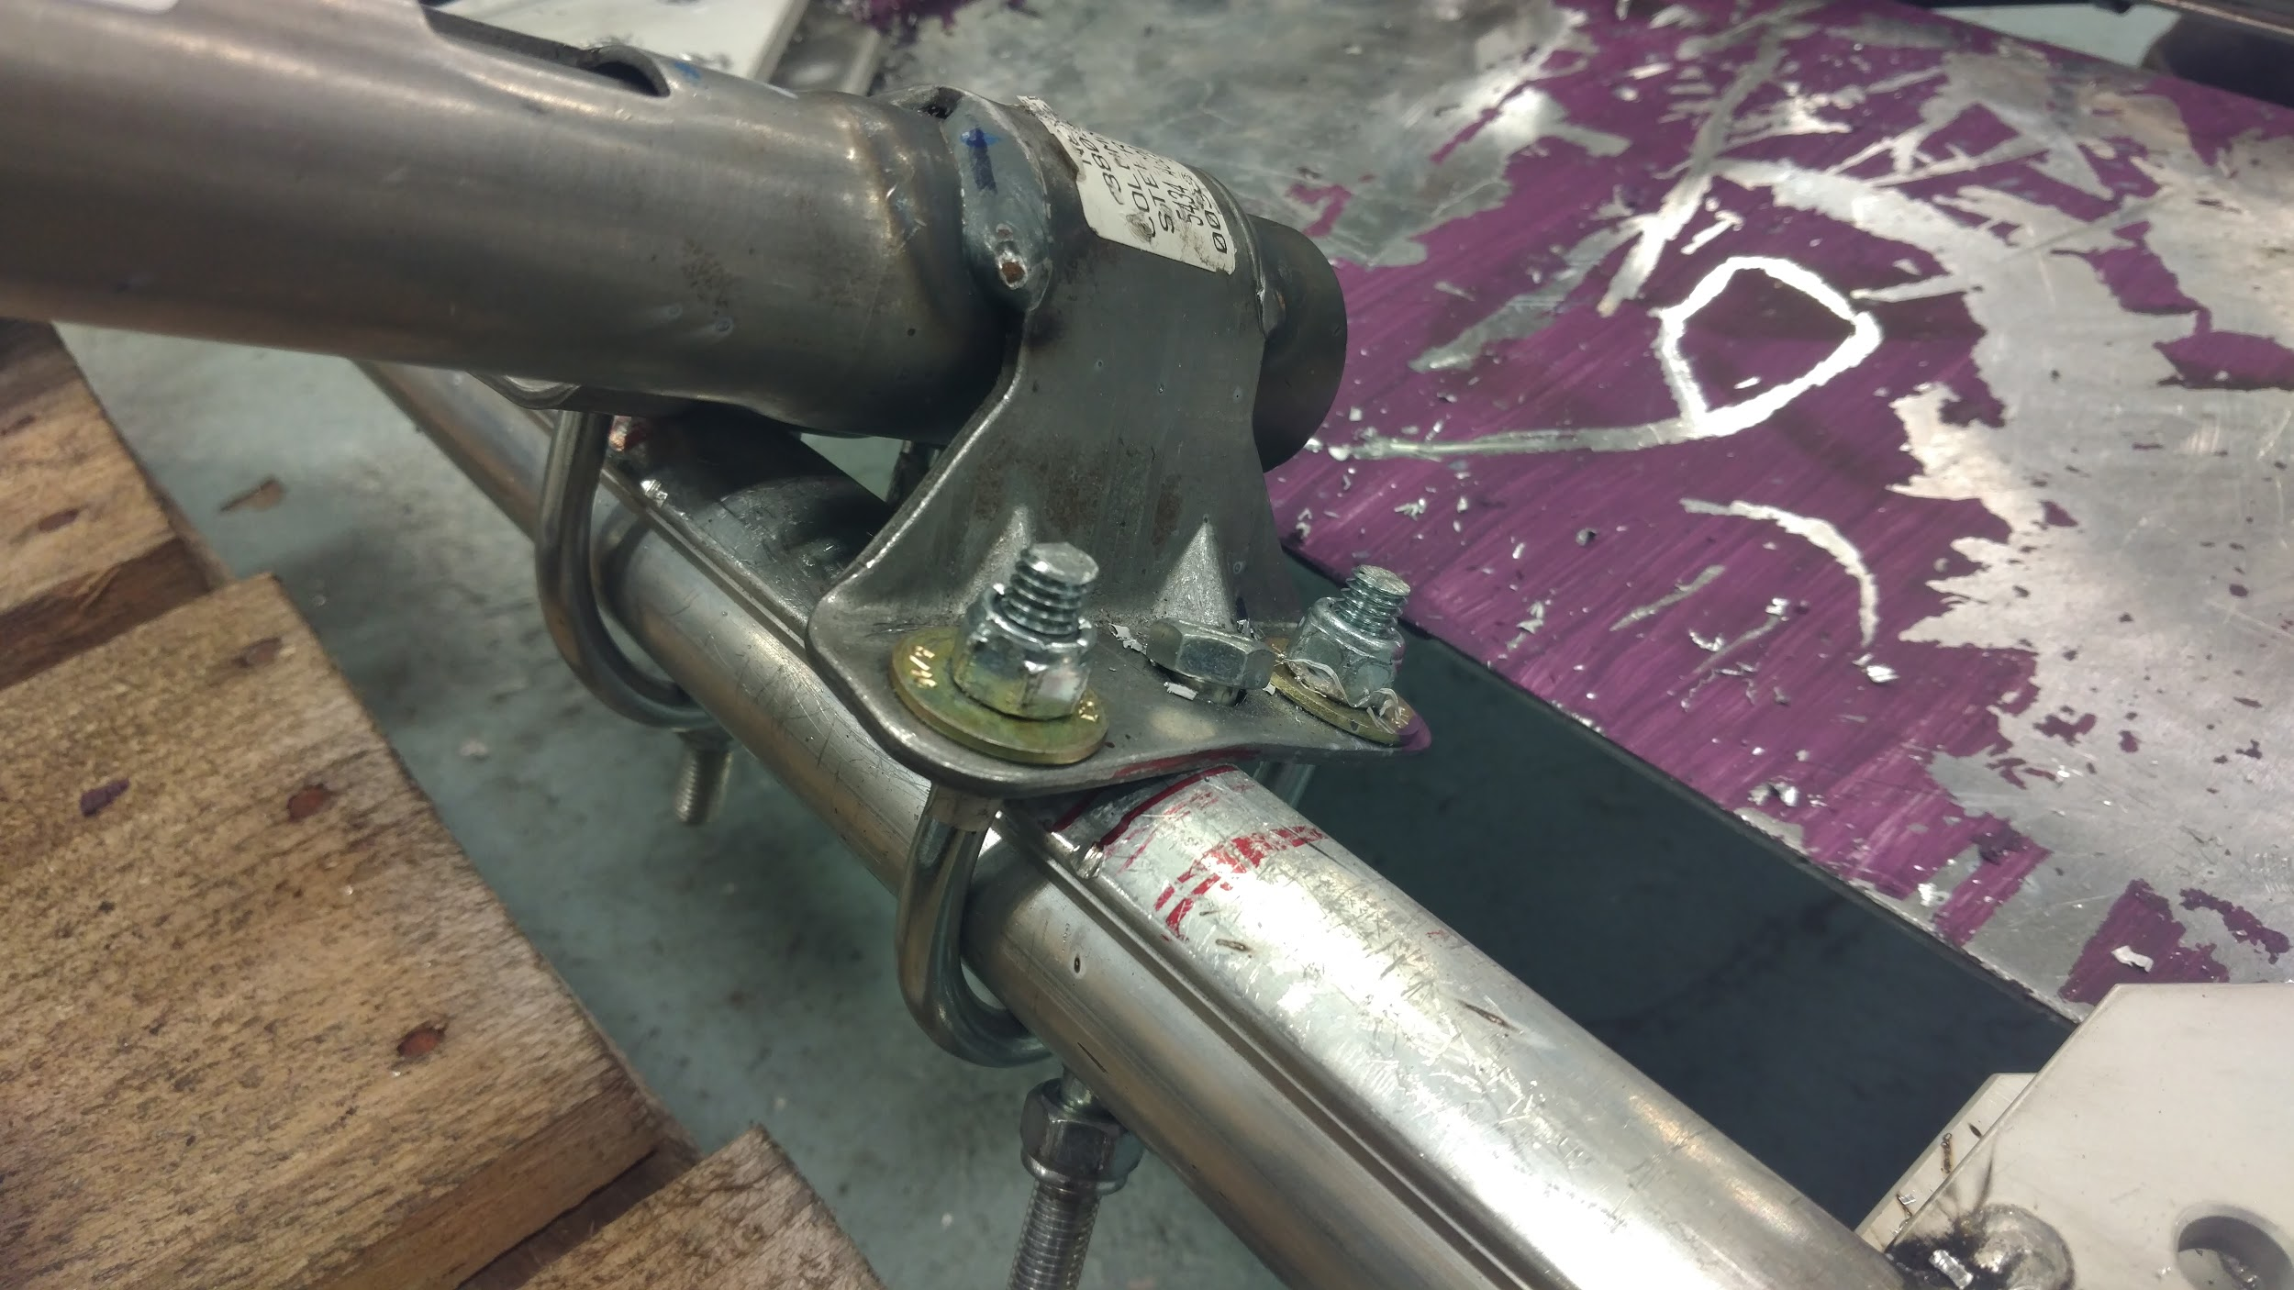
Steering Design: Steering Column Visuals
Weld between aluminum U-joint hinge and aluminum shaft
Bolt through frame prevents rotation
Steel Plates welded to base
Steel base
Angle keeps U-joint straight
U-bolt holds base to frame
U-joint welded to steel plate
Bolt through plates holds tie rods
Notes:
Ryan

Slide 11
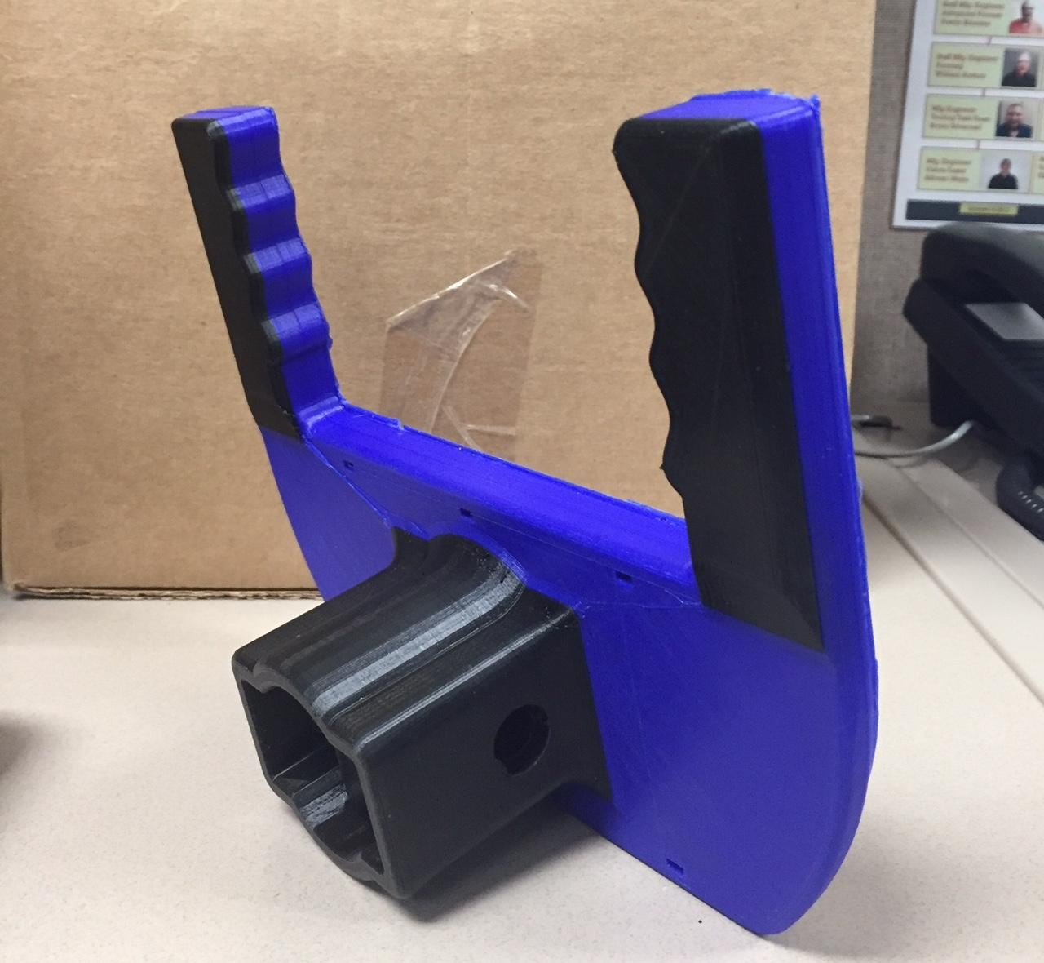
Steering Design: Steering Wheel
3D printed PLA
Bolts to steering column
Accessibility: telescoping and adjustable in vertical and horizontal directions.
Throttle attached to left side via metal plate zip tied to left side.
Notes:
Ryan

Slide 12
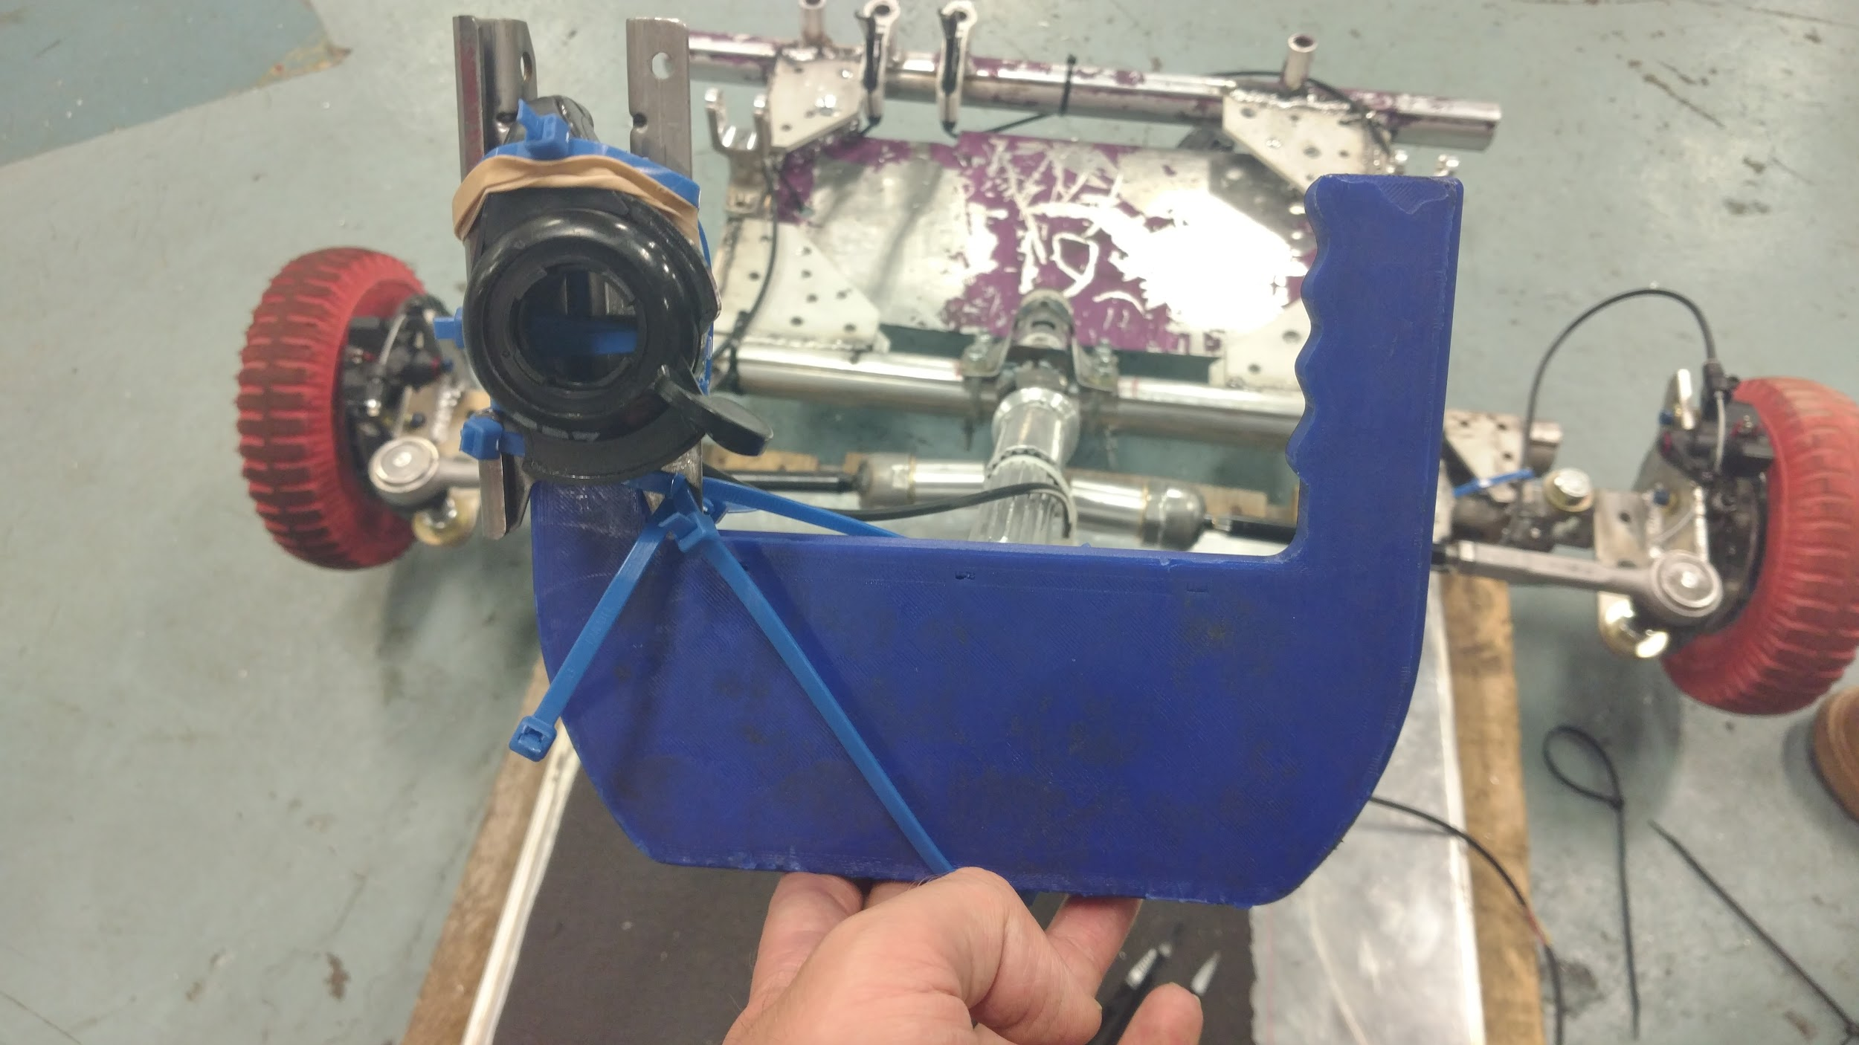
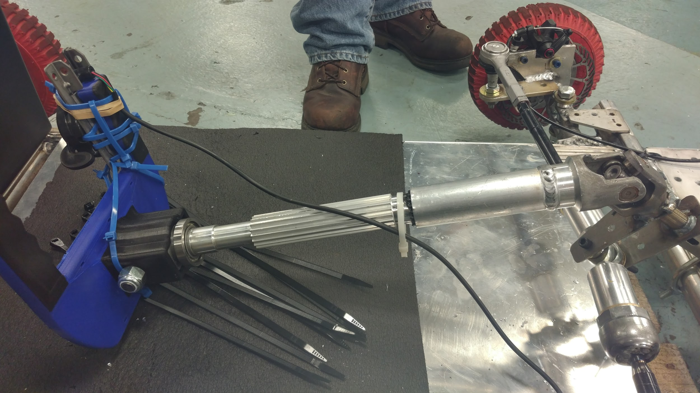
Steering Design: Steering Wheel Visuals
Dual color
Metal plate constrains throttle
Grooves for hand
Throttle and plate attached via Nexteer zip ties
Telescoping
Attached via bolt through U-joint side
85% infill PLA Core
Notes:
Ryan

Slide 13
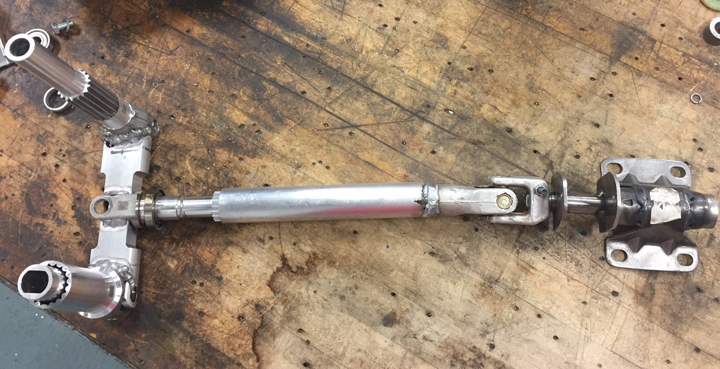
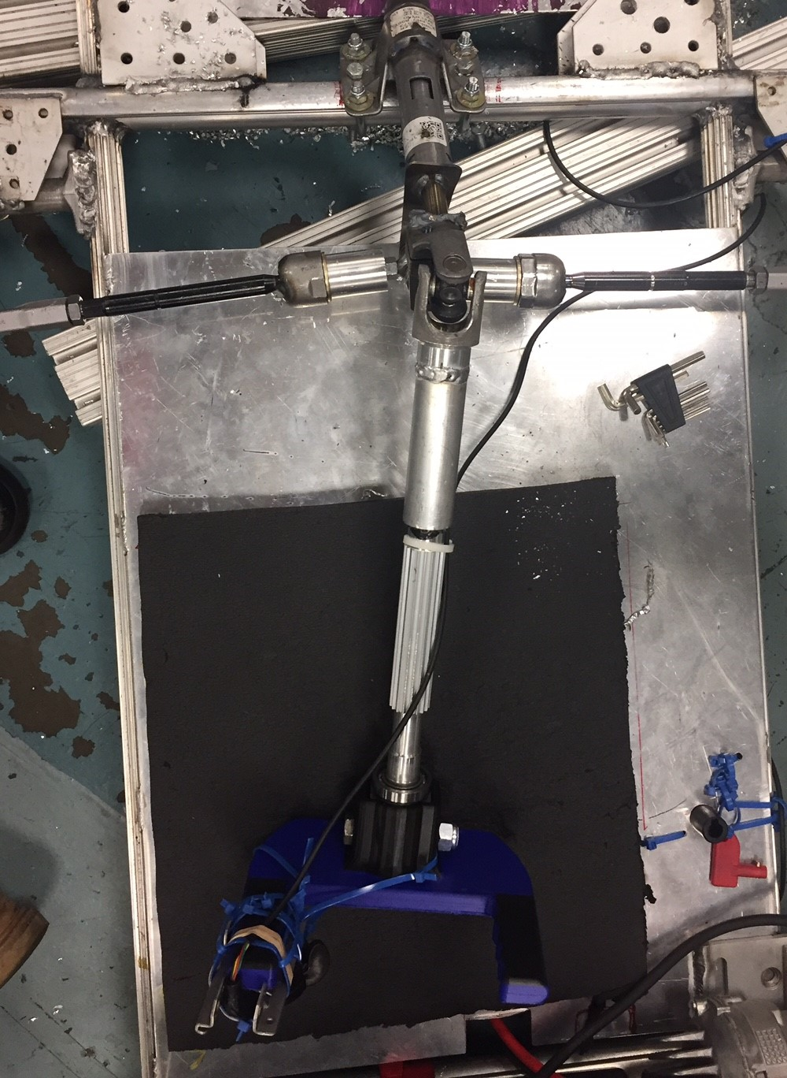
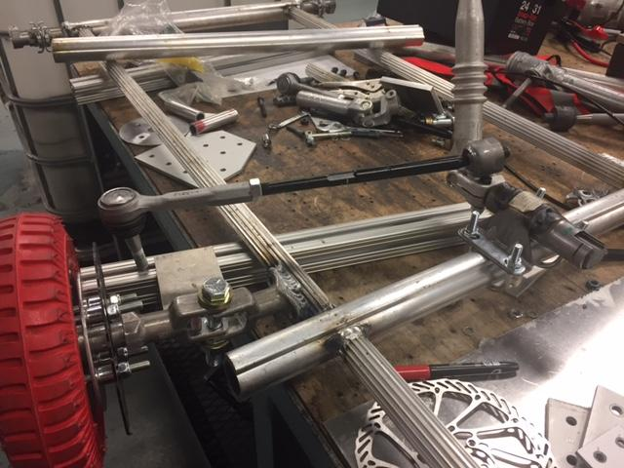
Steering Design: Old vs New Overview
Previous Design
Final Design
Notes:
Ryan

Slide 14
Steering Design: Old vs New Changes
Throttle switched from pedal to on steering wheel.
Original steel piece of column had 1 bearing, changed to piece with 2 bearings to eliminate lash.
Column remade to fit new steel piece, but followed same concept.
Bolts added to steel piece going through frame to stop rotation of steel piece.
Notes:
Ryan

Slide 15
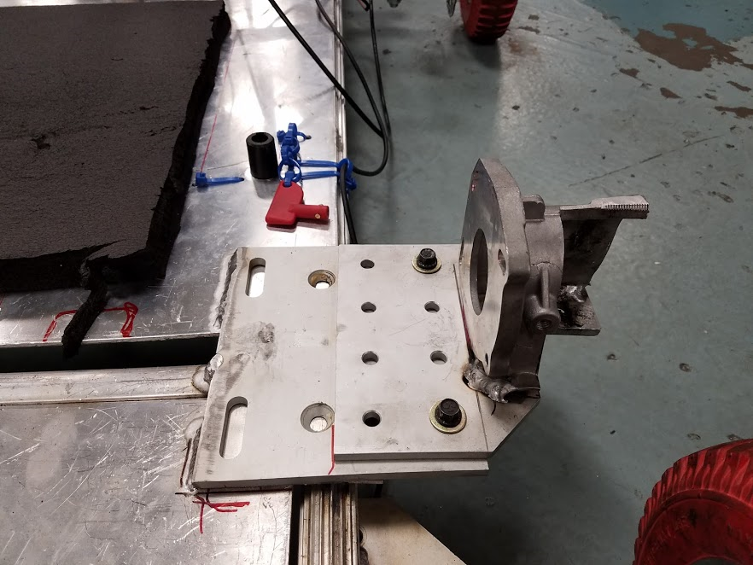
Drivetrain
The drivetrain consists of using a #35 chain drive from the motor to the right rear wheel.
A 9 tooth sprocket with a set screw is attached to the motor shaft for adjustability.
With testing we decided the final ratios for each race. A larger 4:1 gear ratio is intended for the driver switching race while a 3:1 ratio is intended for the final race. A 5:1 gear ratio was used for the durability trials.
Notes:
Charles

Slide 16
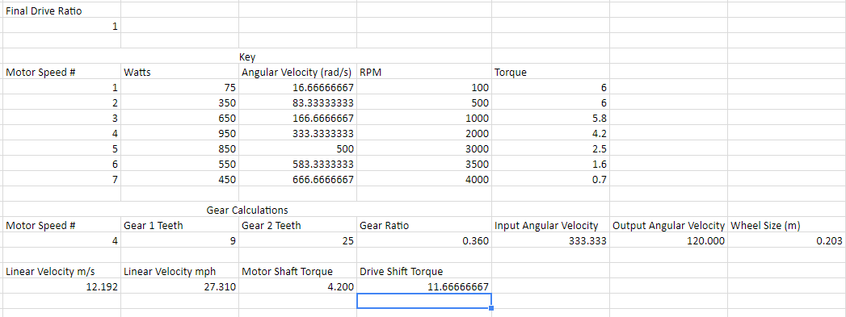
Drivetrain: Gear Calculations
Notes:
Charles

Slide 17
Drivetrain Attachment
The motor is mounted to the rear of the frame using a modified K2 rack cover and 80-20 aluminum brackets to shield part of the drivetrain and mount the motor to the chassis ​
One bracket has slots that allow tensioning of the drivetrain as well as slight alignment adjusting.
The shaft of the K2 motor is used to align the two sprockets.
The driven sprocket is attached to the wheel with a custom bushing.
Notes:
Charles

Slide 18
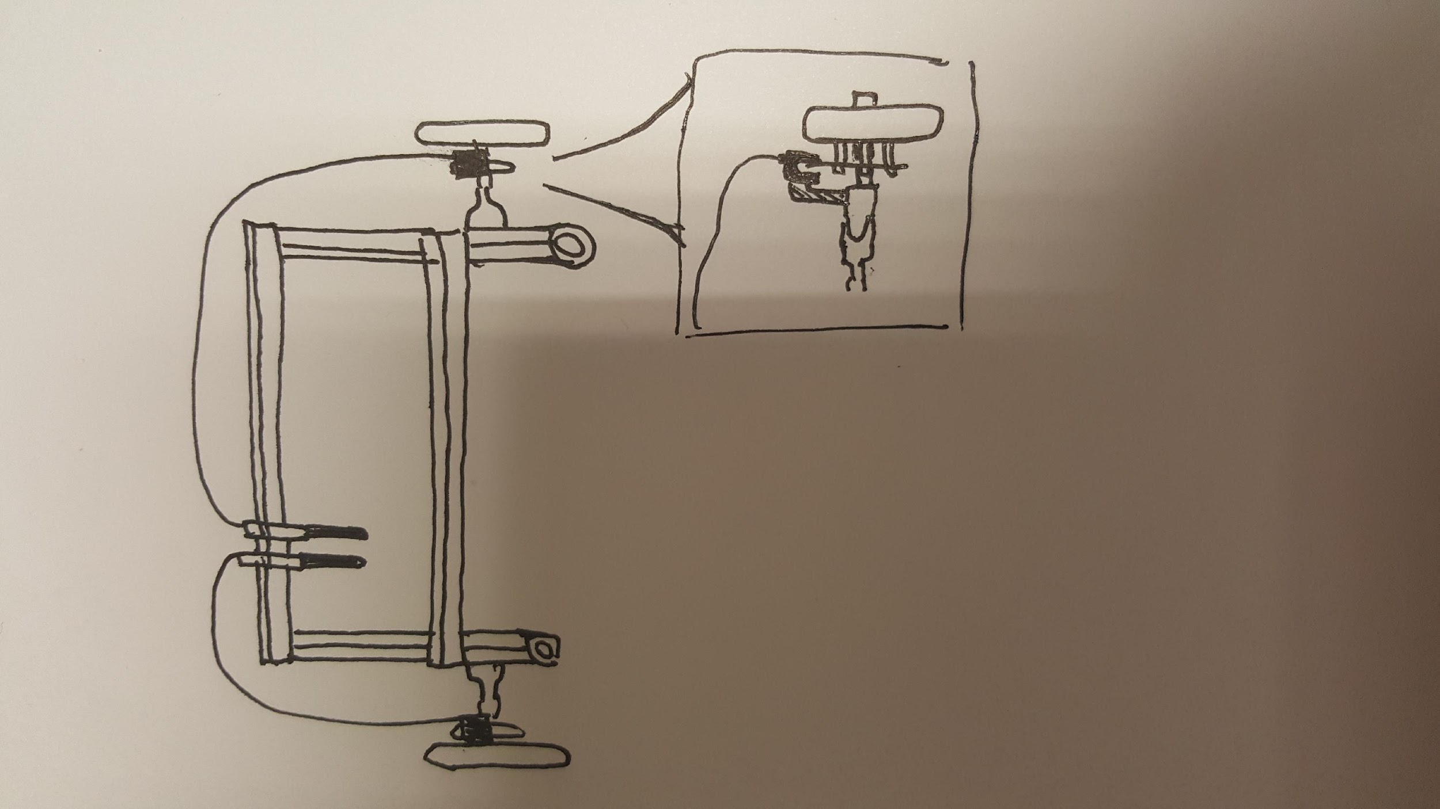
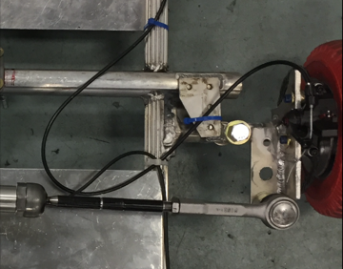
Brakes
Two bicycle disc brakes are attached to the front tires, and the two corresponding bike brake handles are attached to the front of the frame.
160mm rotor diameter
calipers attached to vertical plates
paired brake handles in footwell allows for left/right brake bias during turn in
(Initial Concept)

Slide 19
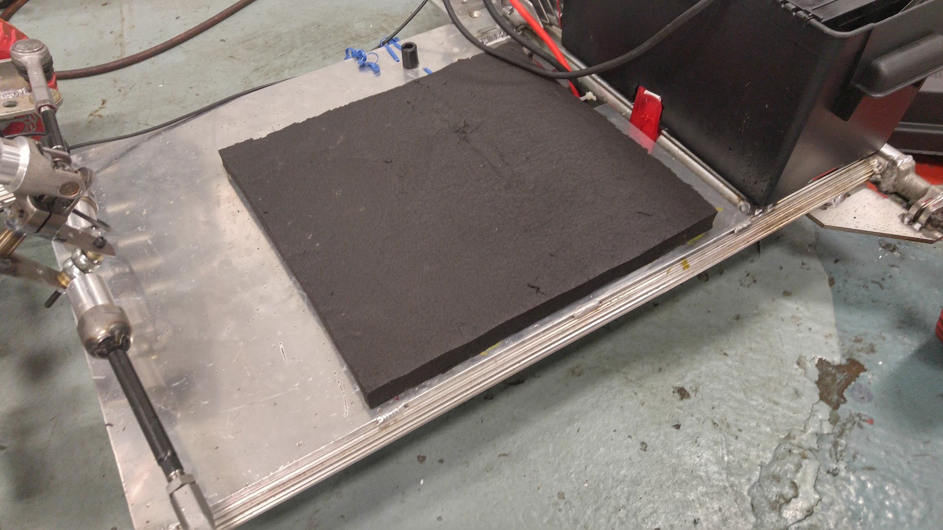
Seating
Seating is Foam Pad
Added so driver doesn't slide off
Dead pedals mounted in footwell near brakes to allow for enhanced driver support throughout cornering

Slide 20
Failures and Testing
Finished early to allow for shakedown
Issues and areas for improvement
Original steering proved to be too heavy and unpredictable
got in the way when changing drivers (approx 5 sec)
Brakes were too tight
when applied, the kart would unpredictably turn left/right
Friction between drivewheel and chassis was clearly audible
loss of speed
Front footwell broke off during the lap
result of pushing on the dead pedals
Metal seat was too slippery during corners

Slide 21
Failures and Testing
Solutions
Steering
changed steering to current design
lighter, precise, predictable, durable
added ability to steer while leaning into the corner with universal joint (i shaft joint)
universal joint also allows us to get in and out of the cart without steering column getting in the way
faster driver changes during heat race (approx 2 sec)
Brakes
tuned brakes to allow for more pedal travel before engagement
along with improved steering, braking under speed drastically improved

Slide 22
Failures and Testing
Solutions
Collar Friction
used thrust bearings to reduce friction between wheels and chassis
Wheel Bearing Friction
pressed out wheel bearings to press in new and better bearings
flange on new bearing prevented hub assembly from fitting
ended up pressing new bearings onto the wheel and replacing all wheels
helped reduce rolling friction

Slide 23
Failures and Testing
Front frame
frame was reinforced with 80-20 brackets
new dead pedals attached closer to driver to reduce moment force
Seat
foam pad glued onto metal plate to help prevent the driver from sliding

Slide 24
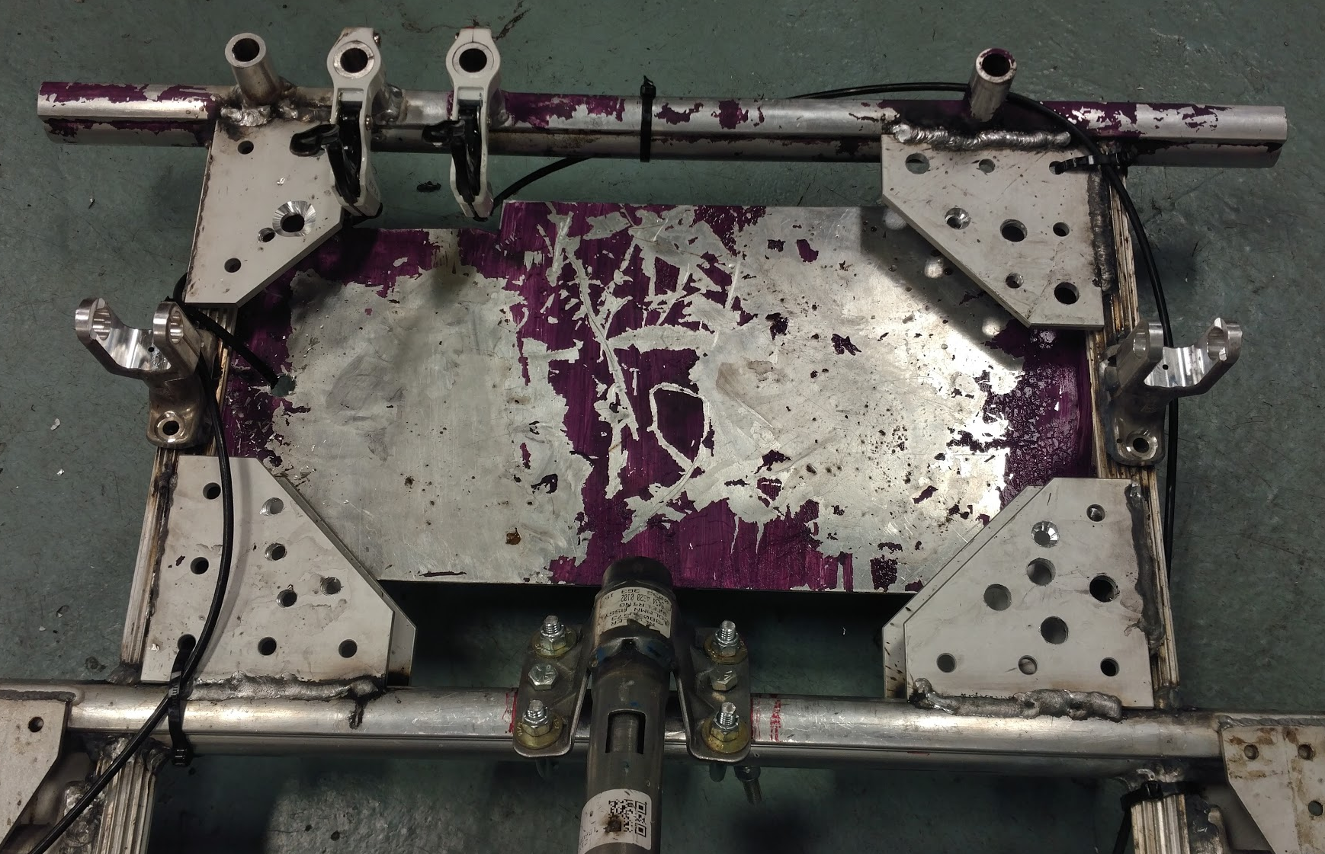
Failures and Testing: Reinforcing Visuals
Extra pedals for bracing feet
Reinforced plates for front of frame

Slide 25
Budget and Parts Summary
Total Nexteer Parts: 96
Upper Steering:11
Lower Steering & Frame: 17
Misc: 68
Budget Spent: $266.41
Budget Remaining: $33.59
Quantity of Bought Parts: 33
Notes:
Jordan

Slide 26
Nexteer Scrap Part List-Lower Steering and Frame
Scrap Part | Part No. | Quantity | Use
Lower Steering Shaft | 38024621 | - | Frame
*6105 Wrought Aluminum | 33009105 | 10
Lower Steering Shaft | 38029094 | - | Lower Steering
*Lower Shaft Bearing Assembly | 38012694 | 1
*Wave Retaining Ring | 38026809 | 1
*Steering Column Jacket Assembly | 26113592 | -
**Bracket and Jacket Assembly | 26113593 | 1
**Upper Bearing Assembly | 26113596 | 1
*identification label | 38029286 | 1
Steering Shaft Assembly | 38029131 | - | Lower Steering
*Shaft Lock Sleeve | 26114337 | 1
*Steering Column Shaft | 38029130 | 1
Total Lower Steering & Frame |  | 17
Notes:
Jordan

Slide 27
Nexteer Scrap Part List- Upper Steering
Scrap Part | Part No. | Quantity | Use
Lower Bearing Lock Sleeve and Yoke assembly | 38209158 |  | Upper Steering
*Tolerance Ring | 38023569 | 1
*Slip Clutch Assist Ring | 38027175 | 1
*Lithium Soap Grease | 00005495 | 1
*Lower Bearing and Yoke Assembly | 38209164 | -
**Lower Bearing Assembly | 38019081 | 1
**Steering Shaft Steake Yoke | 38201274 | 1
Upper And Lower Shaft Assembly | 38020415 | - | Upper Steering
*Lower Overmold Shaft | 38018609 | -
**Lower Steering Shaft | 38018610 | 1
**Nylon 12 HS Plastic | 00005538 | 1
*Upper Steering Shaft | 38018604 | --
**Upper Stub Shaft | 38018606 | 1
**Tubular Shaft | 38018605 | 1
**Synthetic Lithium Grease | 28293461 | 1
**Washer Head Screw | 07849055 | 1
Total Upper Steering |  | 11
Notes:
Jordan

Slide 28
Nexteer Scrap Part List
Scrap Part | Part No. | Quantity | Use
Steering Shaft Coupling Bolt | 26043051 | 8
Torque Tension Hex Nut | 26025433 | 8 | Entire Cart
Yoke Bushing | 38232116 | 2
Motor Housing | 28309903 | 1 | Motor Housing
*External Torx Screw(M6) | 38003121 | 4
PTFE Filled Synthetic Grease | 09986139 | 1 | Wheels
Steering Coupling Assembly | 38228610 | - | Feet Bracers/Front & Rear Axle
*Flange Yoke and Bushing Assembly | 38228611 | -
**Yoke Bushing | 38232116 | 2
**Steering Flange Yoke | 38219756 | 6
Flange Yoke and Coupling Assembly | 38228613 |  | Connect Wheels
*Flange ad Pin Yoke | 38219759 | 2
*Flex Coupling Reinforcement | 38230444 | 4
Total Misc: |  | 38
Notes:
Jordan

Slide 29
Nexteer Scrap Part List
Scrap Part | Part No. | Quantity | Use
Inter-Steering Shaft Assembly | 38201993 | - | I-Shaft between Steering Shaft
*Steering Gear Yoke | 38027516 | 1
*Universal Spider Joint | 38218552 | 1
*Needle Bearing Assembly | 28141425 | 4
Outer Left Hand Tie-rod | 28296472 | 1 | Steering-Tire Connection
Outer Right Hand Tie-rod | 28296473 | 1 | Steering-Tire Connection
Inner Tie-rod | 38003666 | 2 | Steering-Tire Connection
Anti-Rotation Zip Ties | 26101257 | 10 | Entire Cart
Tubular Steering Shaft Assembly | 38200910 | 10 | Chassis
Total Misc: |  | 30
Notes:
Jordan

Slide 30
Budget
Date | Name/Description | Store | Cost per Item | Quantity | Total Cost | Budget Remaining
6/27/2017 | Wheels | Harbor Freight | $7.99 | 4 | ($31.96) | $268.04
6/29/2017 | Brake Set | Amazon | $30.99 | 1 | ($30.99) | $237.05
7/6/2017 | Fasteners | Wohfeil | $5.19 | 1 | ($5.19) | $231.86
7/6/2017 | 5/8-11x6 Hex Cap | Wohfeil | $3.19 | 2 | ($6.38) | $225.48
7/6/2017 | 5/16 1 in bushing | Wohfeil | $2.55 | 2 | ($5.10) | $220.38
7/6/2017 | Bolt U 5/16 x 2 x 3 | Wohfeil | $2.39 | 2 | ($4.78) | $215.60
7/6/2017 | 9/16 - 12 x 4 Hex | Wohfeil | $2.09 | 2 | ($4.18) | $211.42
7/6/2017 | 5/8 1 in spacer | Wohfeil | $2.05 | 2 | ($4.10) | $207.32
7/6/2017 | 5/8 1 in spacer | Clark | $1.69 | 2 | ($3.38) | $203.94
7/6/2017 | 5/8 - 11 nut | Wohfeil | $0.52 | 2 | ($1.04) | $202.90
7/6/2017 | 9/16 - 12 nuts | Wohfeil | $0.43 | 2 | ($0.86) | $202.04
7/7/2017 | 40 tooth sprocket | Mcmaster | $39.08 | 1 | ($39.08) | $162.96
7/7/2017 | 27 tooth sprocket | Amazon | $18.07 | 1 | ($18.17) | $144.79
7/7/2017 | #35 Chain, 10ft | Amazon | $16.99 | 1 | ($16.99) | $127.80
7/7/2017 | Battery Box | Walmart | $9.64 | 1 | ($9.64) | $118.16
7/7/2017 | 9 tooth sprocket | Mcmaster | $9.01 | 1 | ($9.01) | $109.15
8/4/2017 | Sprocket | Amazon | $9.51 | 1 | ($9.51) | $99.64
8/4/2017 | Sprocket | Mcmaster | 32.17 | 1 | ($32.17) | $67.47
8/4/2017 | Wheels | Harbor Freight | 7.99 | 4 | ($33.88) | $33.59
Total |  |  |  | 33 | $266.41 | $33.59
Notes:
Jordan

Slide 31
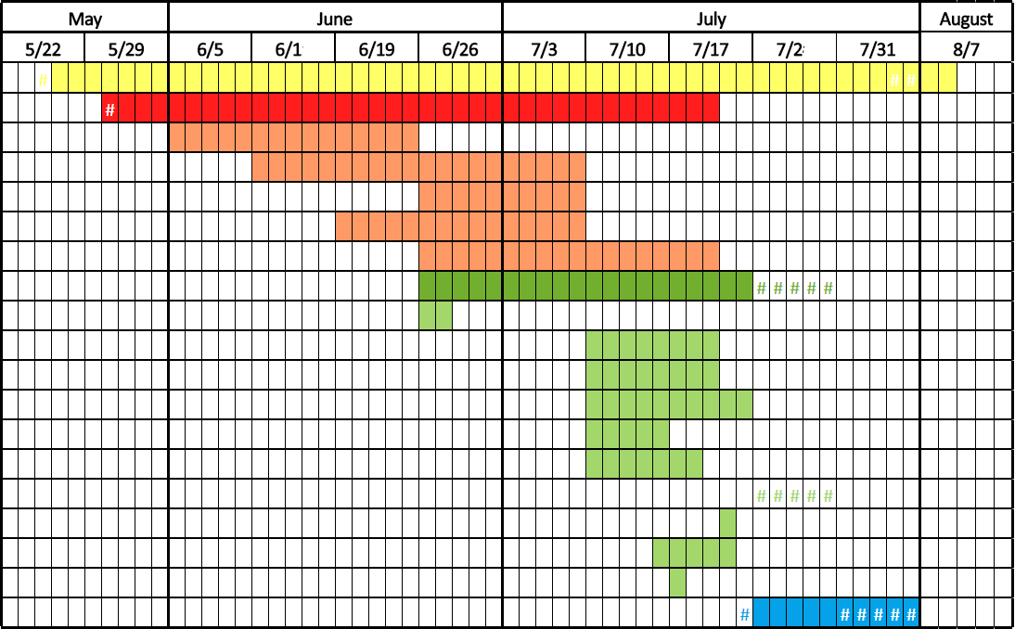
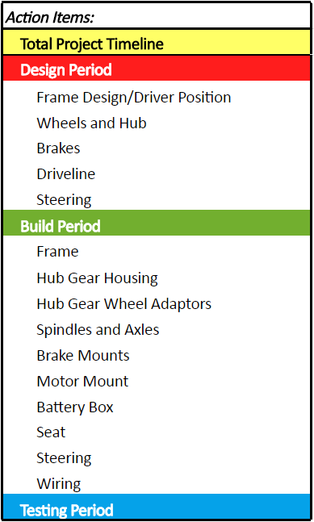
Gantt Chart

Slide 32

Questions?

